Slide 1
JavaScript
CS/IT 490 WD, Fall 2013

Slide 2
TOOLS!
These are the tools I use to test and debug my JavaScript projects.
Firefox!
Web Developer Toolbar
  https://addons.mozilla.org/en-US/firefox/addon/web-developer/
  https://addons.mozilla.org/en-US/firefox/addon/toggle-web-developer-toolbar/

Slide 3
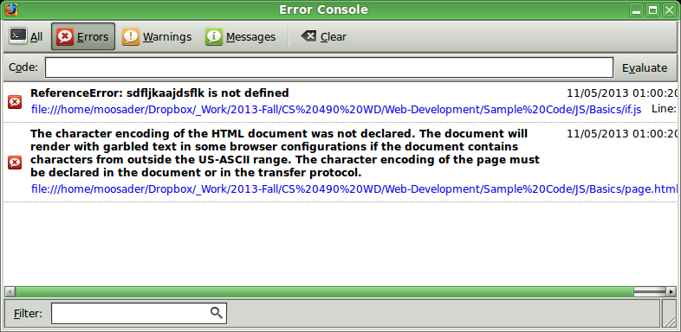
TOOLS!
The Web Developer Toolbar will track errors in your JS code, making it much easier to debug!

Slide 4
Breakdown
What is JS?
What is it good for?
How do you add JS to your page?
Syntax
  Variables & Scope
  Arrays
  Control Flow
  Functions & Anonymous Functions
  JSON Objects

Slide 5
Breakdown
Using JavaScript
  Alerts
  Selecting elements & modifying them
  Timeout and increment timers
  Mouse and keyboard detection
  Simple form validation

Slide 6
What is JS?
JavaScript is a client-side scripting language, while PHP is a server-side scripting language.
JavaScript code runs on the user's machine, rather than the server.
This can make websites appear more interactive, by cleanly transitioning elements, adding animations, and adding nice features.

Slide 7
What is it good for?
JS is good for simple things like Form Validation, where you may not want to wait to refresh the page in order to check if a field is correct.
It can also be used to create beautiful scroller banners, or modal windows, or have your images pop up when you click a thumbnail.

Slide 8
What is it good for?
It can be used with AJAX to call server-side functionality from the client-side.
It can be used with HTML5 to make items similar to what you might have used Silverlight, Flash, Java Applets, or (gasp) Shockwave for in the past!

Slide 9
What is it good for?
Some companies are moving away from Flash (since it's proprietary – owned and controlled by one company) and towards HTML5.
  YouTube has an HTML5 player
  Netflix has a beta HTML5 player, and is pushing for DRM functionality added to the HTML5 standard.

Slide 10
What is it good for?
Web-based applications are much more easily cross-platform than traditional software applications. No download required, no compiling for other OSes.
Even modern smartphones can run JavaScript, even though not all can run Flash.

Slide 11
How do you add JS to your page?
To add JS scripts to your page, you can include them from an external file:
<script src="scripts/config.js"></script>
Or embed them in your markup:
<script>
…
</script>
Though of course, storing them in separate .js files is preferred.

Slide 12
Syntax
Variables & Scope
Arrays & JSON Objects
Control Flow
Functions & Anonymous Functions

Slide 13
Variables & Scope
You can declare a variable with var. This will create a variable that is local in scope.
var age = 100;
If you begin using a variable without first declaring it with var, it will search parent scopes for this variable. If no variable is found, a global variable by the name is created.
age = 100;

Slide 14
Arrays & JSON Objects
You can create an array in JavaScript, by specifying:
var ages = new Array();
Arrays are standard 0, 1, 2, …, n arrays. You can only store integers as the keys, and they are in order.
ages[0] = 20;
ages[1] = 50;

Slide 15
Arrays & JSON Objects
To set an array's values as its declared:
var ages = new Array( 25, 50, 75, 100 );
JS arrays can be resized at any time.
You can also use the push function to add a value to the end of an array.
ages.push( 125 );

Slide 16
Arrays & JSON Objects
You can also store JSON objects in JavaScript.
These are essentially how you can have key-value pairs (associative arrays) that aren't sequential, and can have non-integers for keys.
You can also use JSON objects to imitate a class.

Slide 17
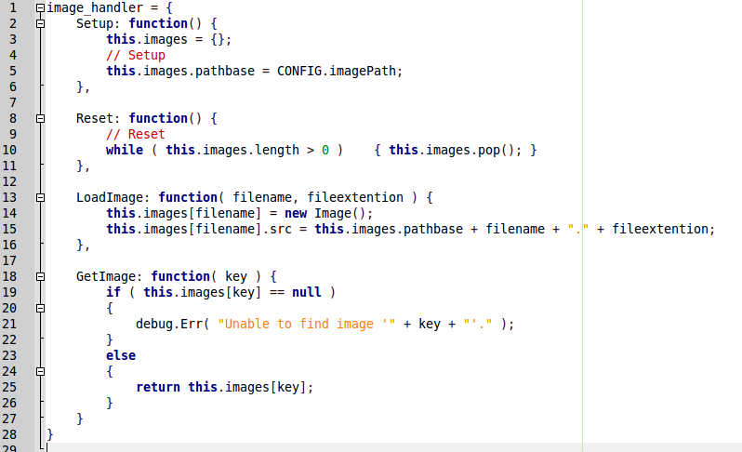
Arrays & JSON Objects
A JSON object, image_handler, which has multiple functions (Setup, Reset, LoadImage, GetImage). It could also store variables as key/value pairs.

Slide 18
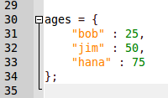
Arrays & JSON Objects
Note that, for most variables in JavaScript we assign them with the equal sign =
Within a JSON object, you specify a key-value pair with a COLON in-between!

Slide 19
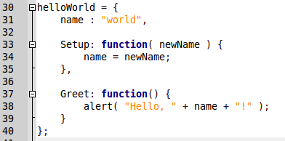
Arrays & JSON Objects
Here, similar to a class, we can declare a variable (name) but also functions (Setup, Greet).
Note that it's the same key-value pair: The function name, and THEN what it is. In this case, a function.
Also note that there should be commas at the end of each element, within the JSON object.

Slide 20
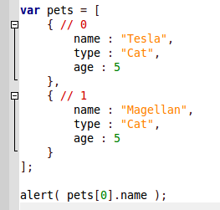
Arrays & JSON Objects
You can make an array of JSON objects by enclosing them with square brackets [ ].

Slide 21
Control Flow
If statements, while loops, for loops are similar to with C++ or PHP.
There is not a foreach loop, unless you use the jQuery library (more on that later).

Slide 22
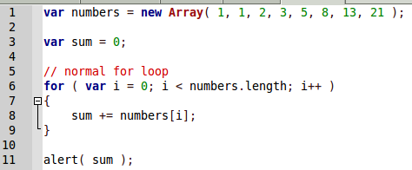
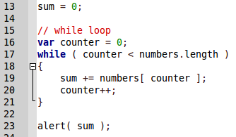
Control Flow
For Loop
While Loop

Slide 23
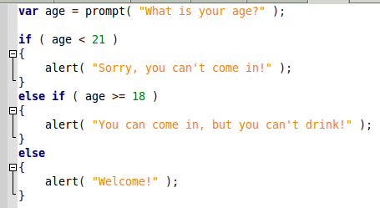
Control Flow
If Statement

Slide 24
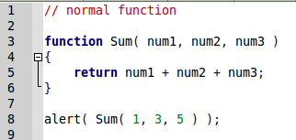
Functions & Anonymous Functions
Functions in JavaScript are declared with the function keyword. You do not need to specify a return-type.

Slide 25
Functions & Anonymous Functions
An Anonymous Function is a function with no name.
In other words, you never declare the function, you simply create it as soon as it is needed.

Slide 26
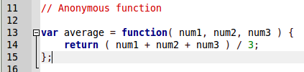
Functions & Anonymous Functions
Notice that we're assigning a value to a variable, but the value we're assigning to it is the return value of the function.
The function has no name, it only exists during this assignment statement. It is anonymous.

Slide 27
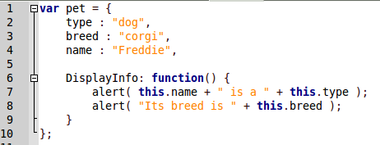
Functions & Anonymous Functions
When you're emulating a class via a JSON object, you're using Anonymous Functions here. (Key-value pairs... the VALUE is an anonymous function).

Slide 28

Functions & Anonymous Functions
And, by referencing the variable DisplayInfo, we call that function.

Slide 29

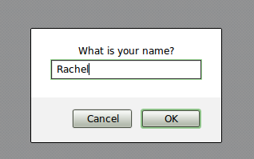
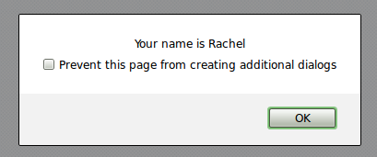
Handy JS Functionality
While really ugly to use on your webpage, you can ask for user input and display popup boxes with prompt and alert.

Slide 30
Handy JS Functionality
You can select XHTML elements by ID or Class with JavaScript
We will cover easier ways to do this with jQuery, too.

Slide 31
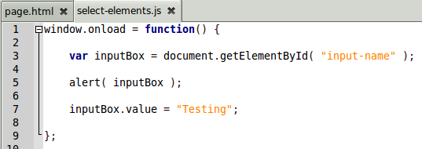
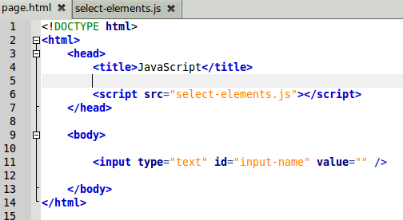
Handy JS Functionality

Slide 32
Handy JS Functionality
We use document.getElementById to select our element.
We can store the 'reference' to this element in the variable, inputBox.
Then, we can change the value while the webpage is running!

Slide 33
Handy JS Functionality
Notice that the above JavaScript is enclosed with window.onload.
If the window.onload function weren't there, we would get a null value when selecting the input-name element.
This is because the JS file is included before the XHTML has rendered. But, we can make our JS run once the page is loaded, similar to above.

Slide 34
Handy JS Functionality
You can change an element's value with .value =
You can change an element's style with .style =
This is all a lot easier and prettier with jQuery, so we're not going to go too in-depth with selecting and altering elements with pure JavaScript.

Slide 35
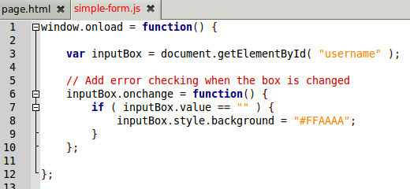
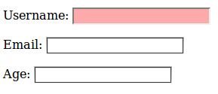
Handy JS Functionality
When the document loads, we can get the input box for “username”.
Then, we can add a callback function, for when that element is changed. (onchange)
Within this callback, anonymous function, we check to see if the field is blank.
If the field is blank, we set its style to have a background of red.

Slide 36


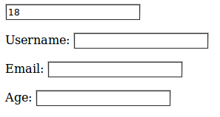
Handy JS Functionality
We can also add timers and timeout functions to our JavaScript...
Our second timer

Slide 37
References
-

